Slide 1
Rerun the TSNE plot with respect to the hidden vectors of the MLP classifier and respectively plot the positive and negative examples.
Study the memory module in ‘ReFresh: Reducing Memory Access from Exploiting Stable Historical Embeddings for Graph Neural Network Training ’ and write the code to realize it (Question: how to obtain the embedding gradient?)
Study a method of visualizing attention weight (seaborn heatmap)

Slide 2
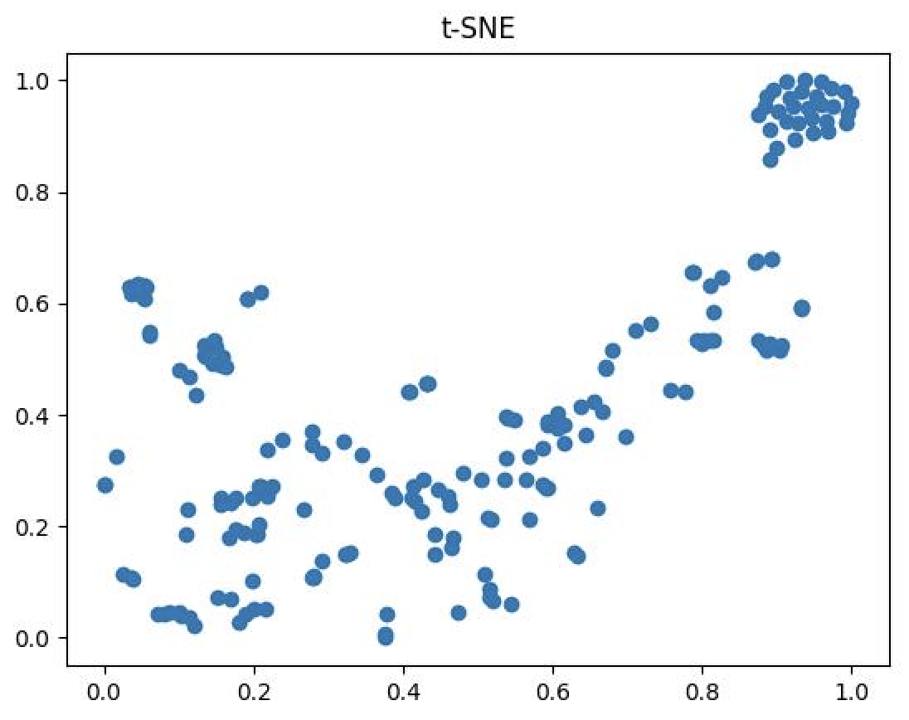
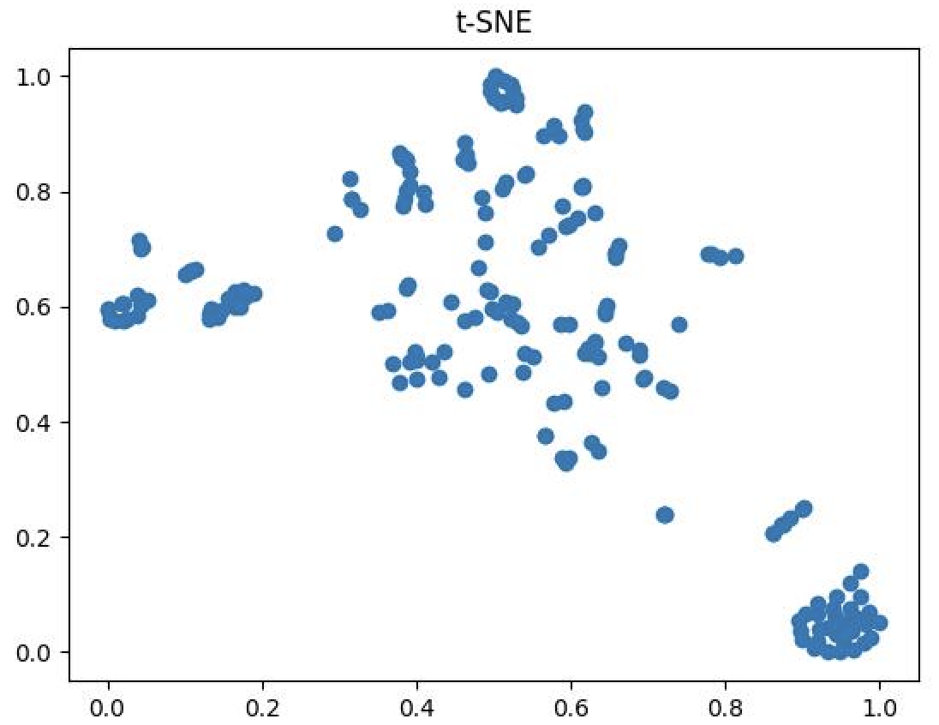
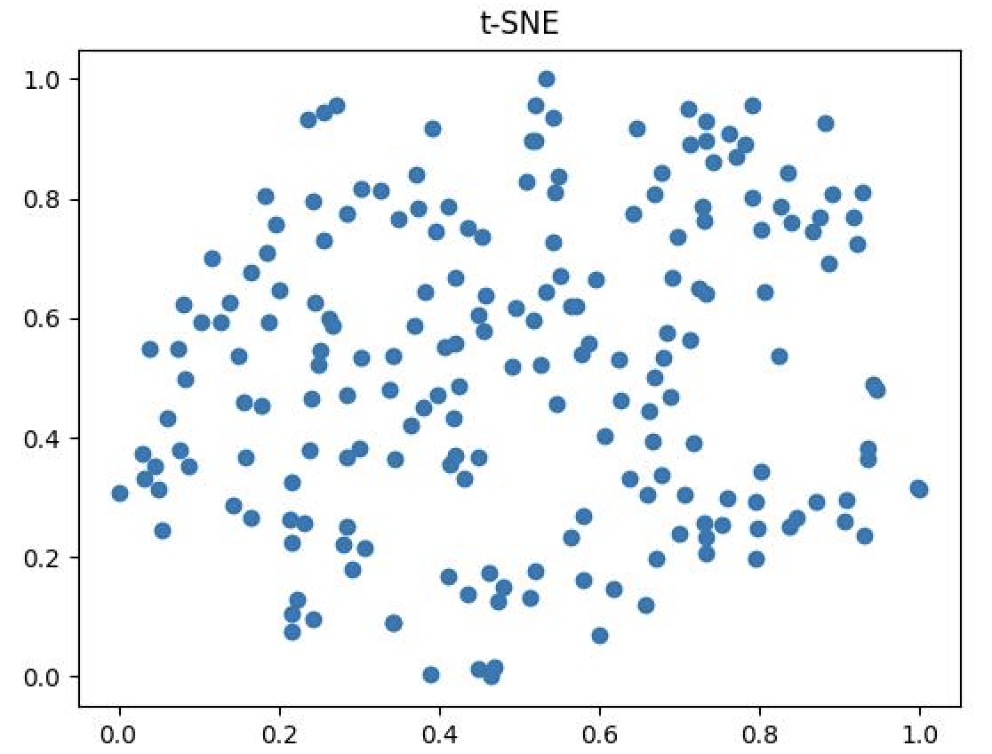
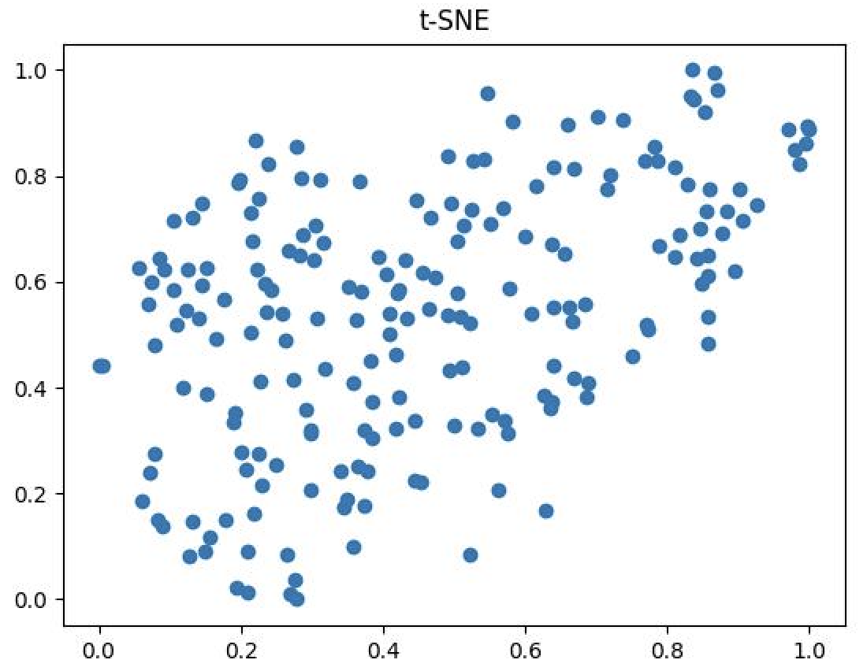
Examples of hidden vectors (positive & negative)
Transductive
Inductive
positive
negative

Slide 3
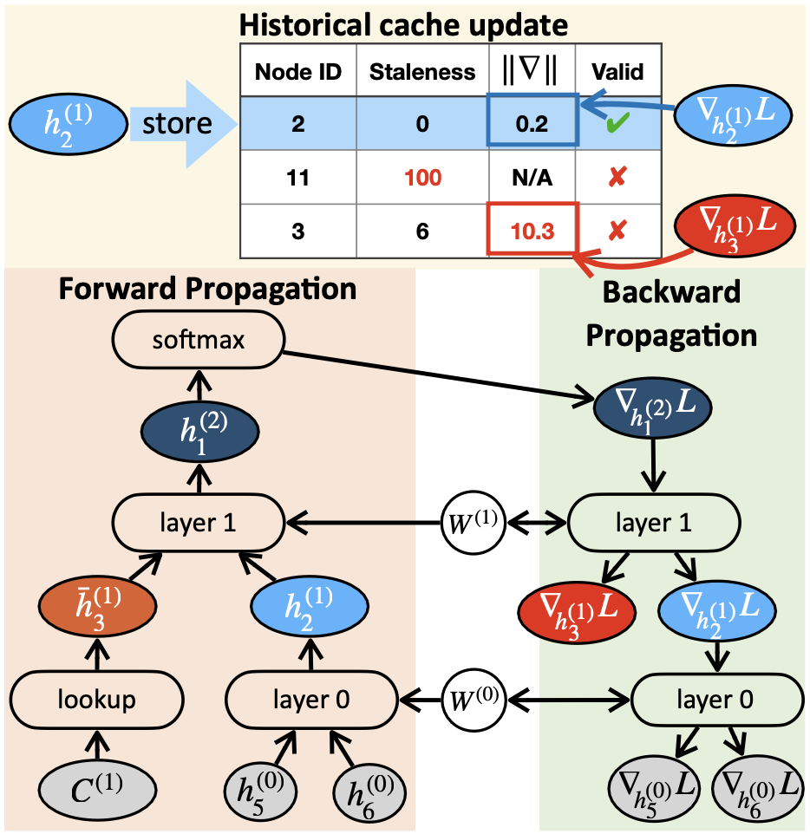
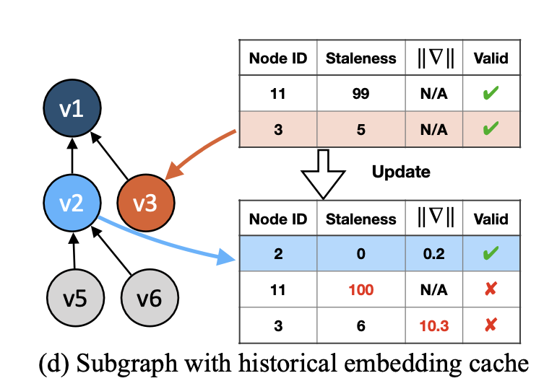
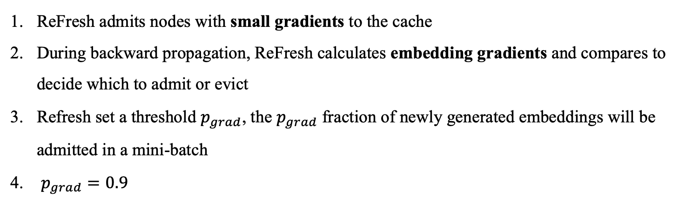
Refresh Cache Policy
Gradient-based Criteria
ReFresh admits nodes with small gradients to the cache
During backward propagation, ReFresh calculates embedding gradients and compares to decide which to admit or evict
Refresh set a threshold $p_{grad}$, the $p_{grad}$ fraction of newly generated embeddings will be admitted in a mini-batch
$p_{grad}=0.9$

Slide 4
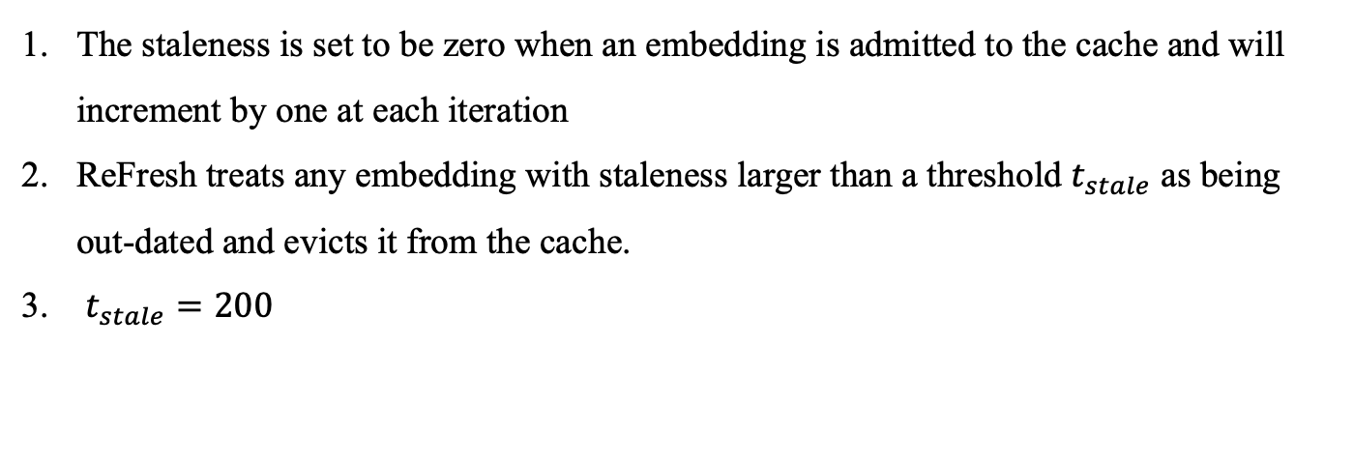
Refresh Cache Policy
Staleness-based Criteria
The staleness is set to be zero when an embedding is admitted to the cache and will increment by one at each iteration
ReFresh treats any embedding with staleness larger than a threshold $t_{stale}$ as being out-dated and evicts it from the cache.
$t_{stale}=200$

